Slide 1
津波による環境効果
エネルギー波及効果： 破壊、侵蝕 &c.
物質移送効果： 氾濫、埋積、汚染 &c.
環境創出効果： 地形、水系、植生 &c.
//初期地球における高分子化効果//

Slide 2
初期地球における高分子化効果 −生物有機物の創出− 生物単量体の生成
The origin of biological monomers
MINOURA, SUGAWARA, IIJIMA

Slide 3
The origin of biological monomers
There is no truly "standard model"
of the origin of biological compounds.

Slide 4
Current models:
Stage 3: The evolution from molecules to cell
Stage 2: The origin of biological polymers
Stage 1: The origin of biological monomers
Precursory stage: The origin of organic molecules

Slide 5
Origin of organic molecules ＞Two possible sources of organic molecules on the early Earth
Terrestrial origins:
Organic synthesis driven by impact shocks or by other energy sources (such as ultraviolet light or electrical discharges; eg. Miller's experiments).
Extraterrestrial origins:
Delivery by objects (e.g. carbonaceous chondrites) or gravitational attraction of organic molecules or primitive life-forms from space.

Slide 6
Theory or hypothesis
＞Soup theory:
＞Deep-sea vent theory:
＞Eigen‘s hypothesis:
Manfred Eigen and Peter Schuster of the Max Planck Institute for Biophysical Chemistry examined the transient stages between the molecular chaos and a self-replicating hypercycle in a prebiotic soup.
＞Wächtershäuser's hypothesis:
The early evolution of life advanced by Günter Wächtershäuser, a Munich chemist. The theory proposes that early life may have formed on the surface of iron sulfide minerals, hence the name. It was developed by retrodiction from extant biochemistry in conjunction with chemical experiments.
＞Radioactive beach hypothesis:
Zachary Adam at the University of Washington claims that stronger tidal processes from a much closer moon may have concentrated grains of uranium and other radioactive elements at the high water mark on primordial beaches where they may have been responsible for generating life's building blocks.
＞Ultraviolet and Temperature-Assisted Replication hypothesis:
Karo Michaelian of the National Autonomous University of Mexico points out that any model for the origin of life must take into account the fact that life is an irreversible thermodynamic process which arises and persists to produce entropy. Entropy production is not incidental to the process of life, but rather the fundamental reason for its existence.
＞Etc.

Slide 7
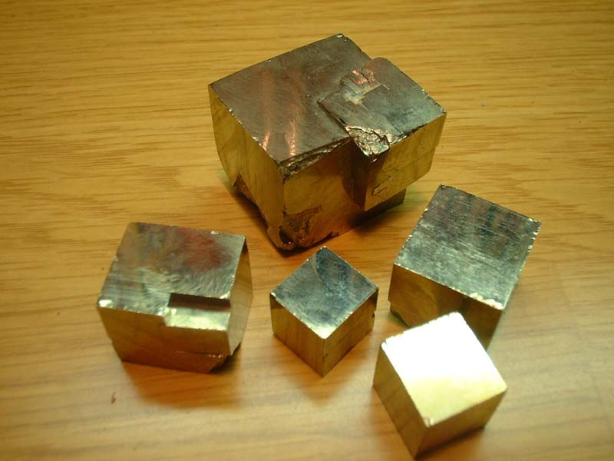
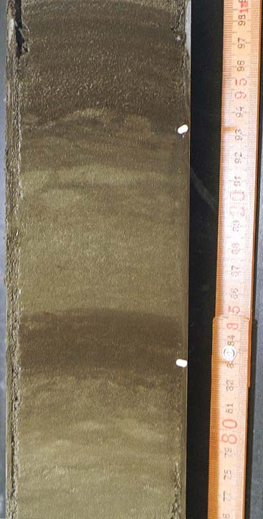
黄鉄鉱単結晶
FeS₂
嫌気層中に晶出する黄鉄鉱

Slide 8
Which are the major pillars of Wächtershäuser's hypothesis? Interview with Günter Wächtershäuser about most relevant principles of autotrophic theory of origin of life.
Answer: The methodology of biochemical retrodiction is the main pillar. It is in essence a methodology of rational theory evolution. By this methodology my theory has greatly evolved over the years. Some of the main features of my theory, which presently I consider to be very important, may be summarized as follows.
Life began as an autocatalytic, chemo-autotrophic surface metabolism of low-molecular organic compounds. These were formed first by CO fixation and later by CO₂ fixation, in a volcanic setting (CO, CO₂, H₂S, NH₃) on the surfaces of colloidal inorganic precipitates of sulfides of iron, nickel and other transition metals. The surface metabolism was driven by the oxidative conversion of CO to CO₂ and by a cascading oxidative conversion of colloidal FeS with the end member FeS₂. The primordial metabolism generated organic constituents that became surface bonded in statu mascendi (in status of birth) and that were activated for further reaction. The surface metabolism evolved (self-expanded) by the addition of autocatalytic feedback loops. This means that the dynamic analogue information of feedback loops preceded the structural digital information of sequences. In detail, the early evolution of life proceeded notably by self-lipophilization, which later led to cellularization; and by ligand replacement notably by peptides and later by coded proteins, which led to enzymatization. The enzymatization occurred one by one. This means that the pre-enzymatic metabolic pattern was conserved throughout the process of enzymatization and this is the reason why the method of biochemical retrodiction is applicable down to the very origin of life.
生物（有機物）は低分子有機化合物の自触媒作用を伴う化学合成独立栄養的表面代謝により出現．

Slide 9
Other scenarios
＞Autocatalysis:
Richard Dawkins wrote about autocatalysis as a potential explanation for the origin of life in his 2004 book “The Ancestor's Tale.” Autocatalysts are substances which catalyze the production of themselves, and therefore have the property of being a simple molecular replicator.
＞Clay theory:
Clay theory postulates that complex organic molecules arose gradually on a pre-existing, non-organic replication platform—silicate crystals in solution. Complexity in companion molecules developed as a function of selection pressures on types of clay crystal is then exapted to serve the replication of organic molecules independently of their silicate "launch stage".
＞Gold's deep-hot biosphere model:
Thomas Gold proposed the theory that life first developed not on the surface of the Earth,
but several kilometers below the surface. Gold's theory is that flow of food is due to out-gassing of primordial methane from the Earth's mantle.
＞Primitive extraterrestrial life:
＞Extraterrestrial amino acids:
＞Polyphosphates:
Polyphosphates are formed by polymerization of ordinary monophosphate ions PO₄₋₃. Several mechanisms for such polymerization have been suggested. Polyphosphates cause polymerization of amino acids into peptides.
＞PAH world hypothesis:
Organic molecules are known to be present in comets and meteorites. In 2004, a team detected traces of polycyclic aromatic hydrocarbons (PAH's) in a nebula.
＞Multiple genesis:
The first organisms were self-replicating iron-rich clays which fixed carbon dioxide into oxalic and other dicarboxylic acids. This system of replicating clays and their metabolic phenotype then evolved into the sulfide rich region of the hotspring acquiring the ability to fix nitrogen. Finally phosphate was incorporated into the evolving system that allowed the synthesis of nucleotides and phospholipids. If biosynthesis recapitulates biopoesis, then the synthesis of amino acids preceded the synthesis of the purine and pyrimidine bases. Furthermore the polymerization of the amino acid thioesters into polypeptides preceded the directed polymerization of amino acid esters by polynucleotides.
＞Etc.

Slide 10
A new scenario
on the origin of organic molecules
＞Autocatalytic, chemo-autotrophic surface metabolism ：
Organic molecules were formed first by CO fixation and later by CO₂ fixation, in an Earth’s primitive setting (CO, CO₂, H₂S, NH₃) on the surfaces of colloidal inorganic precipitates of sulfides of iron, nickel and other transition metals. The surface metabolism was driven by the oxidative conversion of CO to CO₂ and by a cascading oxidative conversion of colloidal FeS with the end member FeS₂.
（低分子有機化合物の自触媒作用を伴う化学合成独立栄養的表面代謝）
Background conditions:
Sediments (clay minerals, fine-grained clastics, metals)
and interstitial chemistries (H₂O, CO, CO₂, H₂S, NH₃)

Slide 11
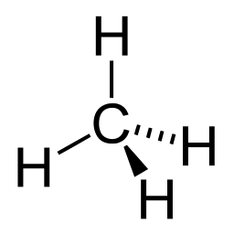
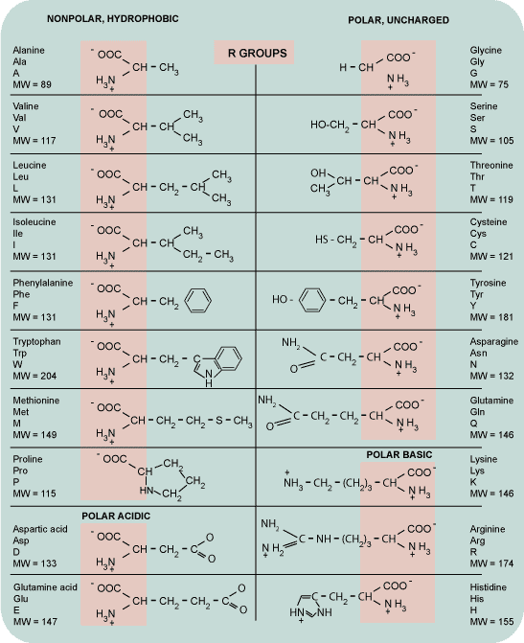
Synthesis of organic compounds
H. James Cleaves et al.:
The action of an electric discharge on reduced gas mixtures such as H₂O, CH₄ and NH₃ (or N₂) results in the production of several biologically important organic compounds including amino acids.
Orig. Life Evol. Biosph., 38, 2008.
Feng Tian et al.:
The efficient production of organics in a hydrogen-rich early Earth’s atmosphere would have led to an organic soup in the oceans and ponds on the early Earth.
Science, 308, 2005.

Slide 12
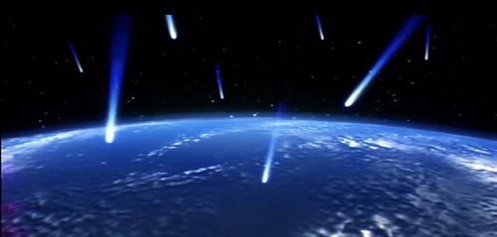
A big bang theory of organic molecules
＞ An elucidation of how the diverse kinds and large
quantities of organic molecules necessary for life
came to exist on Earth, which is rational in terms
of the Earth’s history, is the first problem in explaining the origin of life.
In 2006, on the basis of a consideration based on the view of the Earth at the end of the 20th century and preparatory experimental results, H. Nakazawa proposed a “big bang theory of organic molecules” which stated that “organic molecules formed in diverse kinds and large quantities as a result of the intense bombardment of the oceans of the early Earth by planetoids and meteorites.” This is a new Japanese-originated scenario of the origin of organic molecules.
As grounds for this proposal, in the previous year, 2005, H. Nakazawa and his colleagues demonstrated that ammonia, which is a precursor of the amino acids, forms in large quantity when a shock wave is applied to nitrogen, water, and iron, these being the representative components of the primeval atmosphere, oceans, and meteorites.
生命を創成するに足る十分かつ多様な有機分子は如何にして創成されたか?

Slide 13
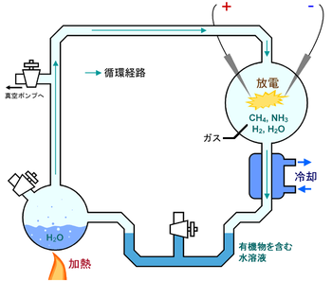
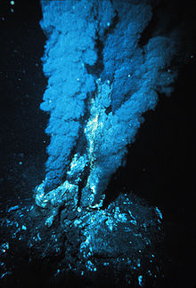
The origin of organic molecules
＞ Organic Molecules Formed by Bombardment of Oceans by Meteorites:
Organic molecules formed in diverse kinds and large quantities as a result of the intense bombardment of the oceans of the early Earth by planetoids and meteorites.
↓
Transient stages between the molecular chaos and a self-replicating hypercycle in a prebiotic soup.

Slide 14
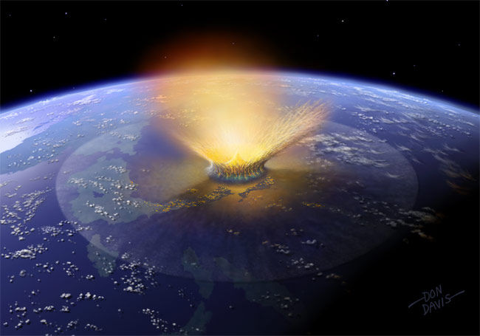
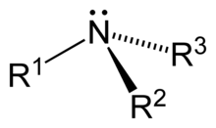
The origin of organic molecules
Organic molecules formed by bombardment of oceans by meteorites
Asteroid collision
↓
Fe, Ni, amorphous carbon, H₂O, N₂ → Carboxylic acids, amine, glycine
要件１：大量の低分子有機化合物が絶えず生成
要件２：生成した有機化合物が保存される条件
大規模・急激堆積作用/埋積作用

Slide 16
有機物表面代謝説
・ジョン・バーナル（1959年）による「粘土説」の提唱：
何らかの界面は化学反応が起き易くなっており、化学反応の触媒としての機能を界面が有し、
粘土の界面上でアミノ酸重合反応が起きる。
・ギュンター・ヴェヒターショイザー（1988年）による『表面代謝説』の提唱：
黄鉄鉱（FeS₂）表面で有機物の重合反応を含めたあらゆる化学反応が生起した原始生命は単
位膜によって覆われず、黄鉄鉱表面に存在する代謝系が生命であった。黄鉄鉱界面上に発生し
た代謝系は二酸化炭素などの無機化合物を炭素源とする生物であり、最初に生まれた生命は
独立栄養生物である（界面上で有機物が発生し、それらが複量体に進化）。黄鉄鉱界面上で発
生したイソプレノイドアルコールは古細菌脂質を構成する物質であり、単位膜によって覆われた
最初の生命は古細菌であると考えられる。
オパーリンの化学進化説によると、初期の生命体は有機物スープを資化していった従属栄養生物であったが、表面代謝説では炭酸固定を行なった独立栄養生物である。
ギ酸生成式：
CO₂ + H₂ → HCOOH (G₀ = 30.2kJ/mol) （１）
FeS + H₂S + CO₂ → FeS₂ + H₂O + HCOOH (G₀ = -11.7kJ/mol) （２）
（１）式は非自発反応（吸エルゴン反応）であり、外部からのエネルギー投入を要求する。（２）式は、黄鉄鉱上でのギ酸生成反応で、自発反応（発エルゴン反応）であり、黄鉄鉱上で有機物の生成が生起し易いことを示している。
発エルゴン反応エネルギー → 非自発反応の促進 ＝ 共役

Slide 17
有機物表面代謝：補足
有機物生成反応のみならず、グリセルアルデヒド-3-リン酸およびジヒドロキシアセトンリン酸では、リン酸基（負に荷電している）が黄鉄鉱界面（正に荷電）に吸着されて配向を保ってお互いの分子が重合する反応が発生し、生成物としてリン酸トリボースというそのままDNAやRNAの材料となる糖新生反応が起きる。このトリボースにイミダゾール環であるプリンやピリミジン塩基が結合することによりTNA（トリボ核酸）が生成し、DNAやRNAの雛形となる。グリセロリン酸を基点として各種アミノ酸が生じるモデルも提唱されている。
膜脂質については、イソプレノイドアルコールが脂肪酸に比べて界面に吸着しやすいため重合反応が見られる。極性脂質誕生以降、ある濃度で脂質がミセル化し、同時に生じたRNAやDNAおよびタンパク質なども同時に遊離し、ミセル化した脂質の袋こそが祖先型の古細菌であるとヴェヒターショイザーは主張している。
表面代謝説は、非常に理論的で明快な結論を引き出している一方、以下の説明が不十分であるために不完全な理論であるとされている。
・古細菌から真正細菌への分化の原因
・転写、翻訳の成立
・能動輸送系の成立
・溶媒中で効率の良い触媒（酵素）の形成過程
表面代謝説は深海熱水孔周辺に黄鉄鉱が多く見られることから、熱水孔を生命の起源と支持する学者の間では人気のある仮説の1つである。事実、黄鉄鉱上で酵素の関与無しに代謝系が生じる可能性を示唆した点は非常に興味深い。また、生命の定義にも議論を投げかけた点において、生命の起源に関する説得力ある仮説として支持され続けている。

Slide 18
表面代謝による生物有機物の起源
表面代謝反応は、以下の化学式で表され、
FeS + H₂S → FeS₂ + H₂
黄鉄鉱の周囲に鉄イオンや硫化水素があれば、自発的に水素イオンと電子を放出する最も単純なエネルギー代謝反応である。
反応系の周囲にCO₂が存在すれば、自発的にギ酸（HCOOH）が生成される。これは、外部のCO₂を有機固定する最も単純な物質代謝反応である。
FeS + H₂S + CO₂ → FeS₂ + H₂O + HCOOH
黄鉄鉱の周囲に｢化学的な不安定さ｣が用意されていれば、そこから電子を取り出して栄養源とする代謝系（独立栄養代謝系）では、細胞膜に包まれていなくても黄鉄鉱の表面で代謝が可能となる。
Background conditions:
Sediments (clay minerals, fine-grained clastics, metals)
and interstitial chemistries (H₂O, CO, CO₂, H₂S, NH₃)

Slide 19
Bombardment of oceans by meteorites
↓
Fe, Ni, Amorphous carbon, H₂O, N₂ → Carboxylic acids, Amine, Glycine
要件１：大量の低分子有機化合物が絶えず生成要件２：生成した有機化合物が保存される条件
大規模・急激堆積作用/埋積作用

Slide 21
Life could have been inorganically started by sulfide minerals on which a succession of biomolecules assembled. Each step incorporates raw materials readily available in tsunami sediments on land.
A ‘reaction wheel’ shows amino acid analogs (outer circle) formed when HMU (center) reacts with various prebiotic molecules.

Slide 22
繰り返す衝突津波の溯上により陸側凹地には金属や有機分子が集積
陸側凹地への海水と金属・有機分子の流入←津波による金属・有機分子の移送←隕石の海洋衝突に伴う有機分子の生成
津波堆積層中の晶出黄鉄鉱表面での自発反応により有機物重合体が生成
津波の戻り波により海洋に流入し集積した有機物
重合体が自然淘汰を受け生物単量体が出現

